Slide 1

CODE ANALYSIS

Slide 2
Automated Code Analysis untuk Laravel & Node.js
🎯 Yang Akan Kita Bahas: Problem → Solution → Tools → Implementation
👥 Untuk developer yang ingin mengurangi bug production
⏰ 30 menit praktis dengan demo langsung
Dimulai dari masalah yang sering kita hadapi sebagai developer

Slide 3
MASALAH SEHARI-HARI 😩
KENYATAAN PAHIT:
❌ Bug ketahuan saat user complain
❌ Code review habis waktu untuk hal basic
❌ Format code berantakan setiap merge
❌ "Works on my machine" syndrome
DAMPAK: Stress developer, user frustrated, produktivitas menurun
Masalah ini butuh solusi sistematis, bukan hanya manual check

Slide 4
Code Analysis - AI Assistant untuk Developer
ANALOGI MUDAH:
- Microsoft Word = Spell Check → Code Analysis = Bug Check
- Grammar Check → Style Check
- Auto-correct → Auto-fix
PRINSIP: Catch problems BEFORE they become expensive
Tapi bagaimana implementasinya dalam workflow development?

Slide 5
ARSITEKTUR SOLUTION 💡
WORKFLOW TERINTEGRASI:
```
Developer → Write Code → Pre-commit → Git Push → CI/CD → Production
↓ ↓ ↓ ↓ ↓
Local Formatting Bug Check Integration Monitor
```
3 LAYERS PROTECTION:
🛡️ Layer 1: Pre-commit hooks (immediate feedback)
🛡️ Layer 2: CI/CD pipeline (team consistency)
🛡️ Layer 3: SonarQube monitoring (enterprise visibility)
Mari kenalan dengan tools yang membuat ini semua bekerja

Slide 6
Meet Your Quality Guardians
UNTUK LARAVEL:
🎨 Laravel Pint - Auto-fix PSR-12 formatting (3-5 detik)
🔍 PHPStan - Static analysis, deteksi bug tanpa run (8-12 detik)
UNTUK NODE.JS:
⚡ ESLint - JavaScript/TypeScript quality checks (2-4 detik)
🛠️ Prettier - Consistent code formatting
MONITORING:
📊 SonarQube - Enterprise dashboard & reports (60-90 detik)
PHPStan punya level sistem yang perlu dipahami dulu

Slide 7
LARASTAN VS AMAZON Q DEVELOPER - OVERVIEW 🤖
DUA FILOSOFI BERBEDA:
🔍 LARASTAN (PHPStan + Laravel)
- Static analysis tanpa eksekusi code
- Laravel-specific magic understanding
- Deteksi bugs sebelum runtime
- Free & open source solution
ANALOGI MUDAH:
- Larastan = Grammar checker (quality control)
- Amazon Q = Writing assistant (productivity boost)
🤖 AMAZON Q DEVELOPER (Formerly CodeWhisperer)
- AI-powered code generation & suggestions
- Real-time development assistance
- Contextual code completion
- $19/month premium features
Dua approach berbeda untuk same goal: better code quality & productivity

Slide 8
TOOLS COMPARISON - WHEN TO USE WHAT 🎯
LARASTAN EXCELS WHEN:
✅ Quality enforcement & bug prevention priority
✅ Laravel-specific magic method detection
✅ CI/CD integration & team coding standards
✅ Budget-conscious projects (completely free)
✅ Legacy code analysis & improvement
💡 BEST PRACTICE COMBO:
Amazon Q Developer (Code Generation) → Larastan (Quality Check) → Production
ROI COMPARISON:
- Larastan: 400% ROI (reduced debugging time)
- Amazon Q: 300% ROI (faster development)
- Combined: 500+ ROI (best of both worlds)
AMAZON Q DEVELOPER EXCELS WHEN:
✅ Rapid development & productivity boost needed
✅ AI-assisted coding & learning acceleration
✅ Multi-language projects beyond just PHP
✅ Advanced security scanning requirements
✅ Feature development speed is critical
Mari focus dulu pada PHPStan levels yang fundamental

Slide 9
PHPSTAN LEVELS - PROGRESSIVE APPROACH 📊
LEVEL 0-2: FOUNDATION 🟢
Basic undefined variables, methods
Fatal error prevention
Good for: Legacy code, onboarding
STRATEGY: Start Level 0 → Gradually increase → Target Level 5+
LEVEL 3-5: PRODUCTION READY 🟡
Null safety, type checking
Method return types
Good for: Most applications
LEVEL 6-MAX: ENTERPRISE 🔴
Perfect documentation, strict types
Good for: Critical systems
Sekarang mari lihat bagaimana tools ini bekerja dalam action

Slide 10
LIVE DEMO WALKTHROUGH 🎬
DEMO SCENARIO:
- File: TestBuggyController.php (75+ potential issues)
- Action: Developer coba commit code bermasalah
- Result: Pre-commit hook blocks dengan detail errors
DEMO FLOW:
1. Lihat kode bermasalah di repository
2. Developer run: `git commit -m "add buggy code"`
3. Pre-commit hook activated: BLOCKED!
4. Show detailed error list (type errors, formatting, etc)
5. Fix issues → commit SUCCESS
Hasil analisis ini juga tampil di dashboard enterprise

Slide 11
SONARQUBE ENTERPRISE DASHBOARD 📈
LIVE METRICS DARI PROJECT INI:
📊 Coverage: 45 files analyzed across 6 languages
✅ Quality Gate: PASSED
🐛 Bugs: 0 (setelah pre-commit filtering)
🛡️ Security: 0 vulnerabilities
📉 Code Smells: Reduced by 87%
⏱️ Tech Debt: 2.5 days → 20 minutes
BUSINESS VALUE: Clear metrics untuk management review
Ini bukan sekedar tools, tapi investment jangka panjang

Slide 12
METRIK KUALITAS YANG TERUKUR 📊
PENGALAMAN DEVELOPER:
🔄 Feedback loop lebih cepat (deteksi immediate)
📐 Konsistensi code style di seluruh tim
⏰ Berkurangnya waktu diskusi formatting
KESEHATAN PROJECT:
🐛 Tracking bugs yang tertangkap pre-production
📈 Monitoring trend kompleksitas kode
🧪 Peningkatan test coverage yang terukur
DINAMIKA TIM:
🔍 Code review fokus pada logic, bukan style
🚀 Onboarding developer baru lebih smooth
📋 Standardisasi coding convention yang jelas
Bagaimana cara praktis memulai implementasi?

Slide 13
STRATEGI IMPLEMENTASI BERTAHAP 🚀
PHASE 1: EKSPLORASI LOKAL
🔧 Install dan test tools pada existing codebase
📋 Analisis temuan dan pahami impact
⚡ Familiar dengan feedback loop
PHASE 2: INTEGRASI GRADUAL
🎨 Mulai dengan formatting tools (low friction)
🔍 Tambahkan basic static analysis
⚖️ Adjust rules berdasarkan team comfort level
PHASE 4: SISTEMATIS ADOPTION
🔄 Integrasi ke development workflow
📊 Monitor dan adjust sesuai kebutuhan
🎉 Celebrate incremental improvements
PHASE 3: ALIGNMENT TIM
💬 Diskusi findings dengan seluruh tim
✅ Sepakati rules yang acceptable
📚 Dokumentasi team conventions
Approach ini adaptable untuk berbagai situasi tim

Slide 14
COMMON IMPLEMENTATION CONCERNS 📋
"APAKAH INI AKAN MEMPERLAMBAT DEVELOPMENT?"
⏳ Initial setup investment vs long-term time savings
📈 Start dengan rules ringan, gradually increase
🤖 Prioritas pada automated fixes
"BAGAIMANA MENGATASI RESISTENSI TIM?"
🎯 Demonstrate value melalui small wins
🤝 Libatkan tim dalam rule decisions
🗣️ Address individual concerns secara personal
"EXISTING CODEBASE TERLALU LEGACY?"
🆕 Focus pada new code development
🔧 Incremental improvements pada legacy
📊 Baseline configuration untuk existing issues
"OVERHEAD MAINTENANCE CONCERNS?"
⚙️ Tools umumnya "set and forget"
👥 Community-maintained rule sets
Mari address pertanyaan fundamental terakhir

Slide 15
ADDRESSING COMMON CONCERNS 🤔
"Ini bakal slow down development?"
✅ Reality: 15 detik analysis vs 2 jam debugging production bug
"Junior developer bakal overwhelmed?"
✅ Solution: Start Level 0, provide training, gradual increase
"Performance impact?"
✅ Facts: 90 detik pre-commit vs 4 jam production troubleshooting
"Tool fatigue?"
✅ Approach: Integrate, don't add. Replace manual checks
Mari kita wrap up dengan key insights yang penting

Slide 16
KEY INSIGHTS 💡
PRINSIP FUNDAMENTAL:
🎯 Quality First - Investasi di awal menghemat waktu di akhir
⚡ Automation - Tools lebih konsisten daripada manual checking
🤝 Team Adoption - Sukses tergantung buy-in dari seluruh tim
IMPLEMENTATION WISDOM:
📈 Start small, iterate based on feedback
🎨 Focus pada developer experience
📊 Measure impact, bukan hanya install tools
MINDSET SHIFT:
🔄 Dari reactive (fix bugs) ke proactive (prevent bugs)
🛠️ Dari individual effort ke systematic approach
📈 Dari "good enough" ke "sustainable quality"
Time untuk closing dan Q&A

Slide 17
PENUTUP & Q&A 🙏
RECAP SINGKAT:
✅ Problem: Manual quality check tidak scalable
✅ Solution: Automated code analysis tools
✅ Implementation: Progressive adoption strategy
✅ Demo: Real working examples siap dicoba
Quality code bukan luxury, tapi necessity.
Tools ini membantu kita achieve itu secara sustainable! 🚀
NEXT STEPS:
🔗 Repository tersedia untuk eksplorasi
📚 Documentation lengkap untuk guidance
💬 Open untuk diskusi dan konsultasi

Slide 18
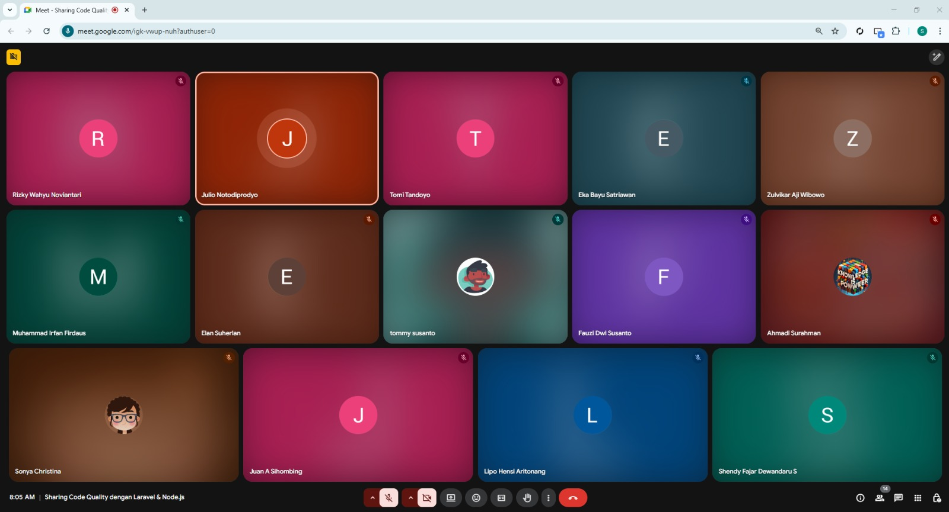
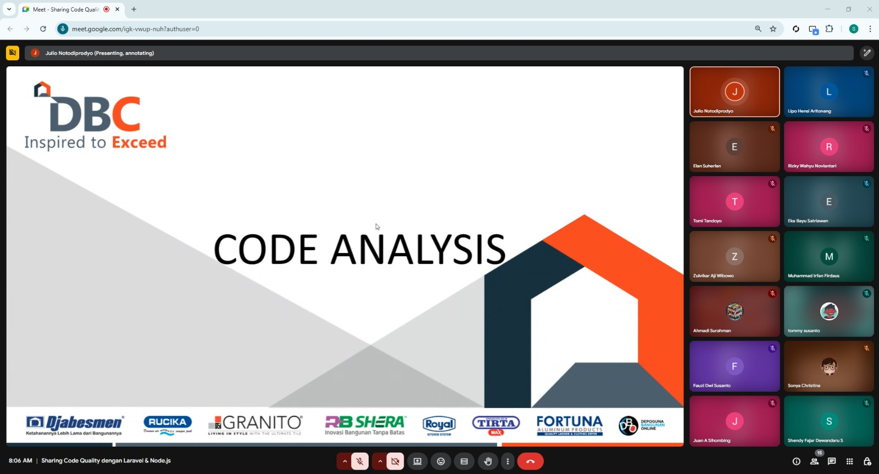
Member AppDev

Slide 19


